Slide 1
Clustering
P 172 – Group 1
VEERAJ BHANGURE
Induri Bharghava Reddy
Urvi Mulchandani
Rahul Govindaraju
Basanagouda Ballolli
Akshay Dnyaneshwar jejurkar
Saket Sharma

Slide 2
Problem statement
- Creating clusters on global development measurement dataset.
The dataset has information about important economic and development metrics related to various countries across the globe.
The dataset has 2704 rows with 25 columns.

Slide 3
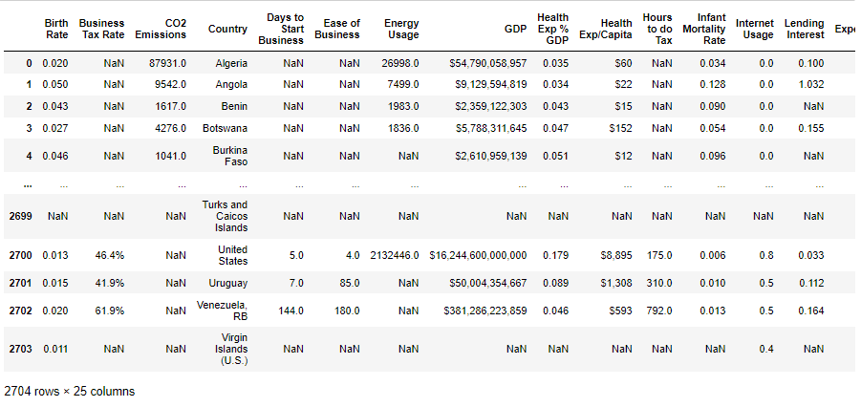
EDA (Exploratory Data Analysis)

Slide 4
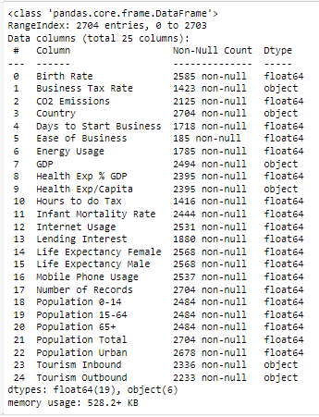

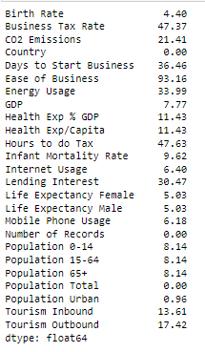
EDA

Slide 5
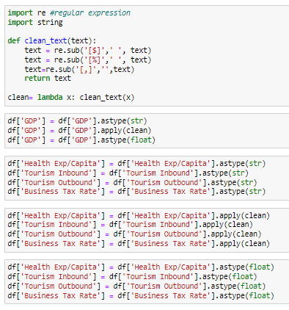
Data cleaning

Slide 6
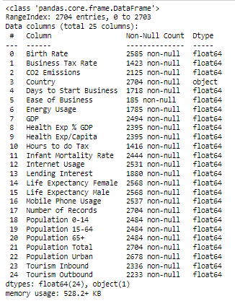
EDA (Exploratory Data Analysis)

Slide 7
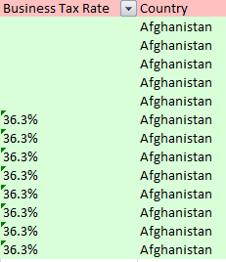
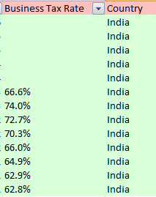
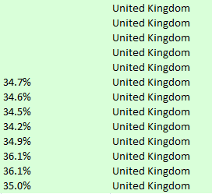
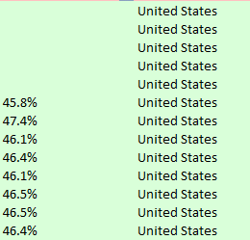
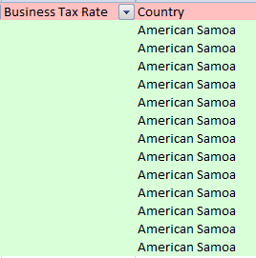
EDA
From above we can say that we can replace the null values of particular country by its mean value we do have some completely null values that can be replace by zero

Slide 8
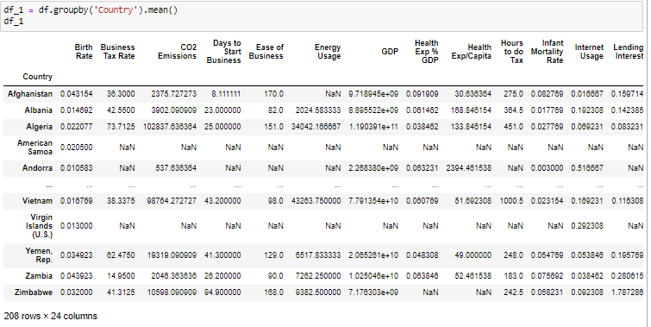
Groupby mean

Slide 9
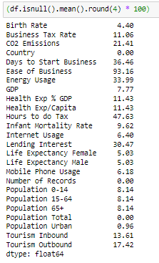
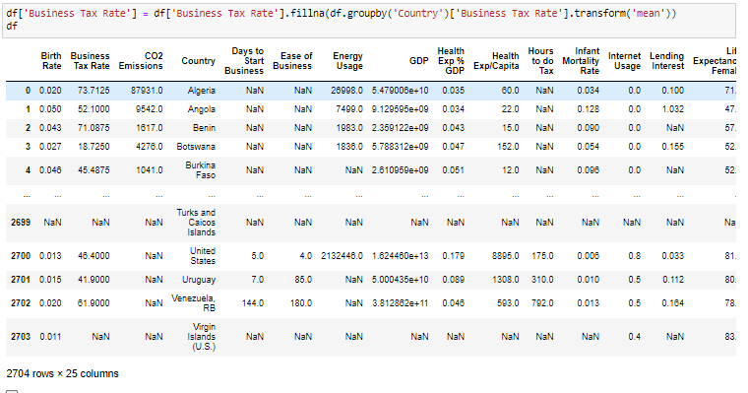

EDA

Slide 10
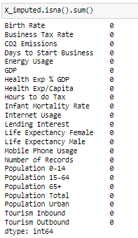

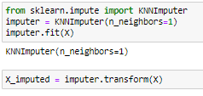
Filling the null values by KNN Imputer

Slide 11
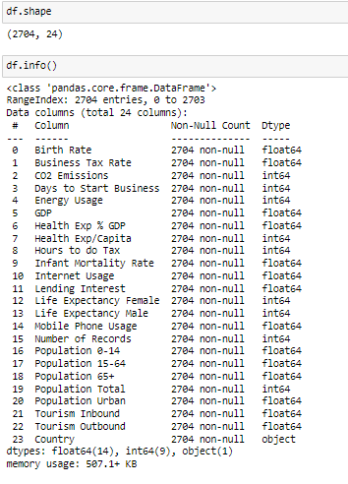
After cleaning the data and filling the null values we can see that we now have 2704 rows with 24 features.

Slide 12
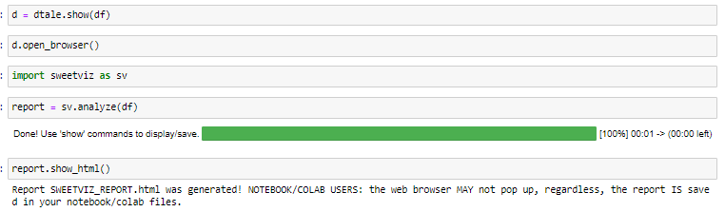
Sweetviz eda
file:///c:/users/lg/pythonfiles/project/p-172-clustering/sweetviz_report.html

Slide 13
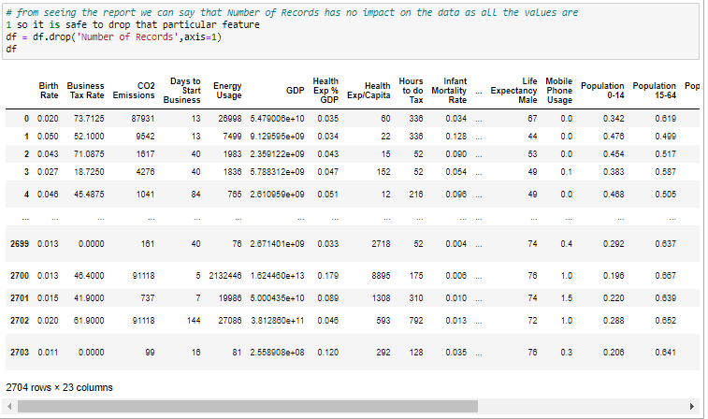
By looking into sweetviz we can say that we can also drop number of records

Slide 14
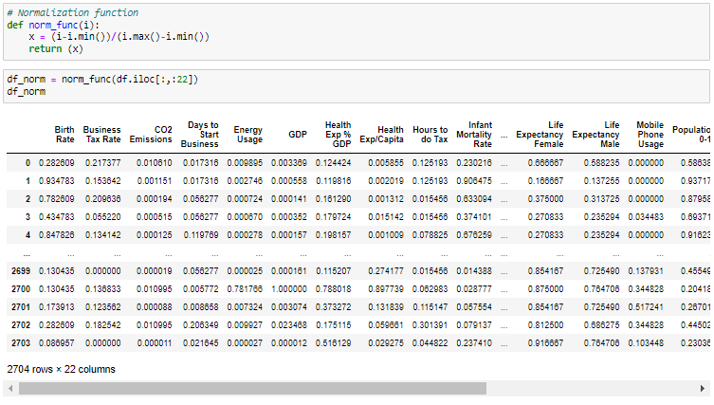
We have applied min max scalar for the data.

Slide 15
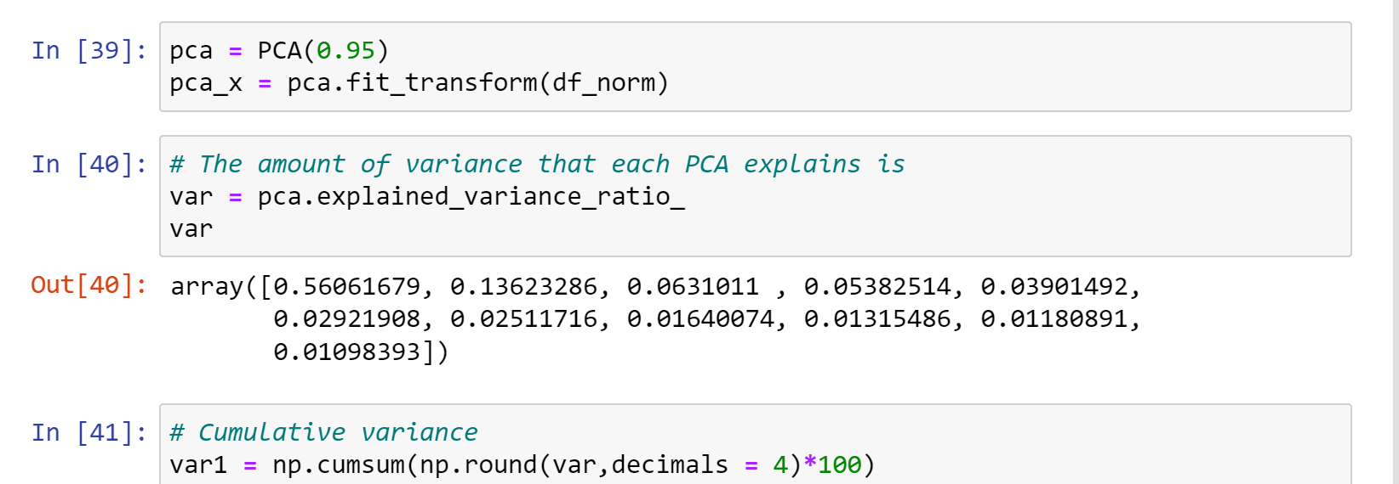
Applying pca normalized data

Slide 16
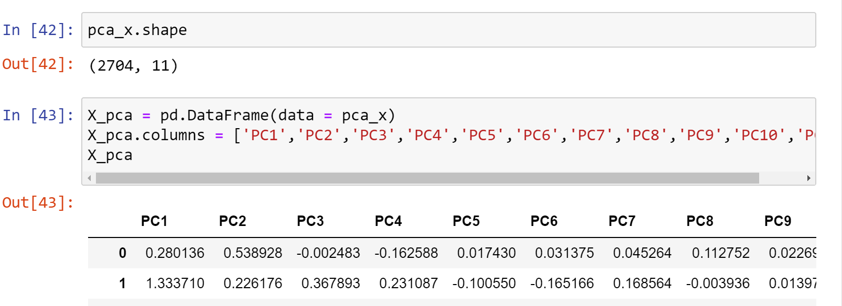
The dimesion of dataframe is reduced from 22 to 11 with help of pca

Slide 17
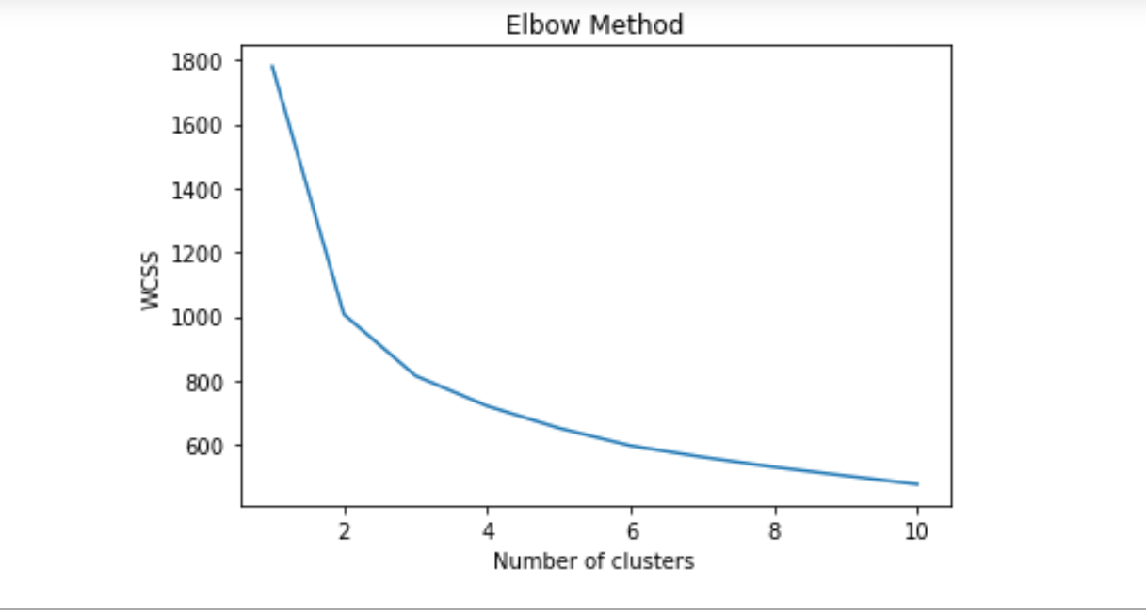
With the help of elbow curve we have decided to form three clusters

Slide 18
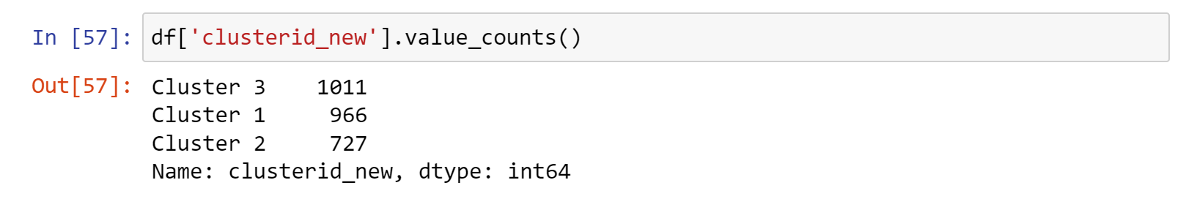
K-means clusters with value counts

Slide 19
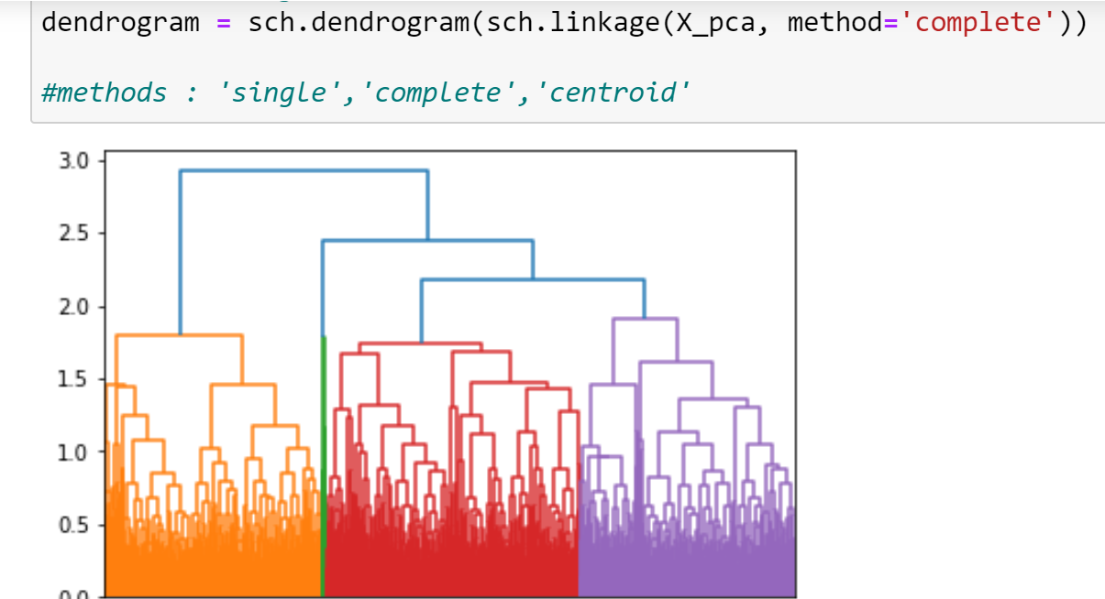
Hierarchical clustering with complete linkage

Slide 20
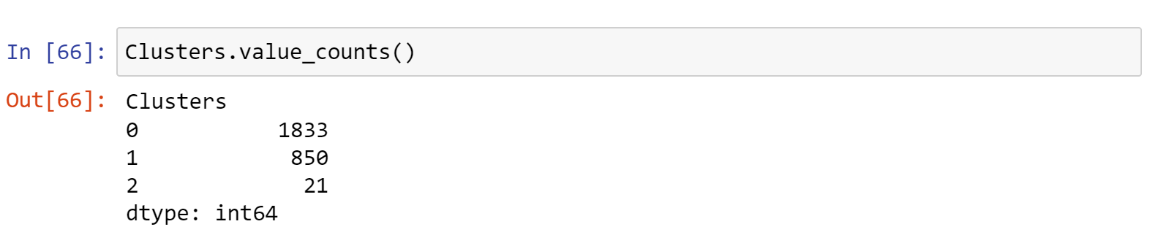
Hierarchical clusters with value counts.

Slide 21
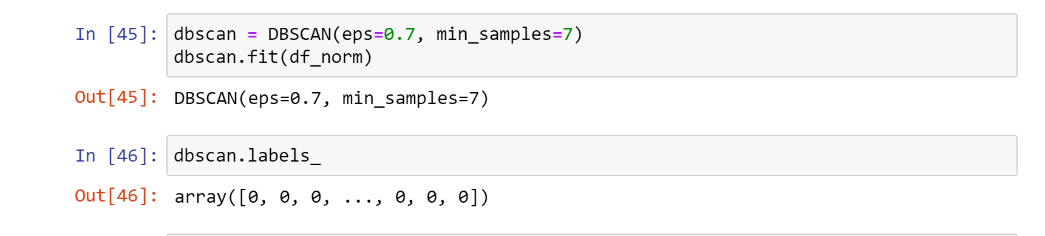
Dbscan clustering

Slide 22
Dbscan have some drawbacks of selecting parameters so we have chosen kmeans and hierarchical clustering

Slide 23
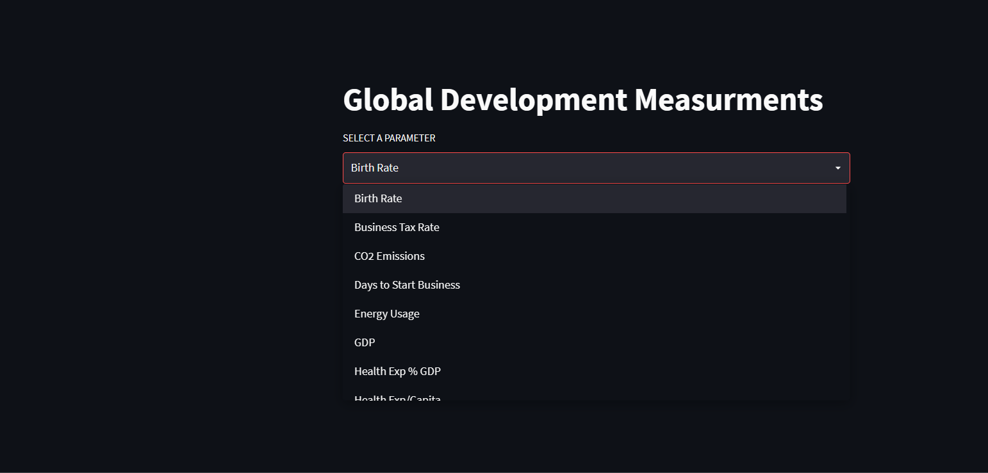
Deployment using Streamlit

Slide 24
Challenges Faced
While cleaning the data as there were many null values
Deciding the number of clusters

Slide 25
Thank you!!

